Slide 1
Google Analytics
It is a web analytics service offered by google that tracks and reports website traffic.

Slide 2
Why Website Owners Need Google Analytics:
We can see how people find our website.
We can find most popular pages on the website.
We gain data who’s visiting our website and how.
How many people visit our website?
It’s free.
It’s easy.
How can we improve our website?

Slide 3
How to add Google Analytics to our Website?
Sign up a google analytics account:
To sign up visit www.google.com/analytics/.
Add website information.
Accept user agreement.

Slide 4
Access Tracking code:
After sign in, We will get a string of HTML code, that is tracking code.

Slide 5
Add the Tracking code to website:
Copy tracking code and paste into the HTML webpage .

Slide 6
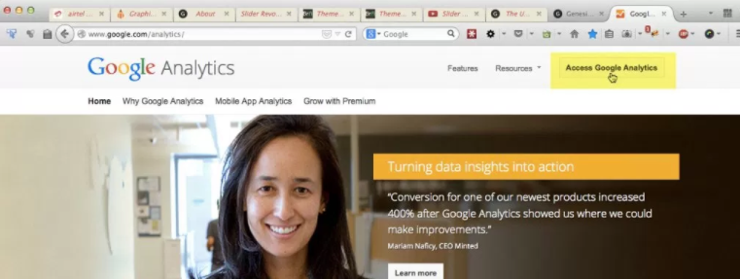
How to install Google Analytics in Website:
Step 1:
Go to https://www.google.com/analytics/ and click on Access Google Analytics at the top right.

Slide 7
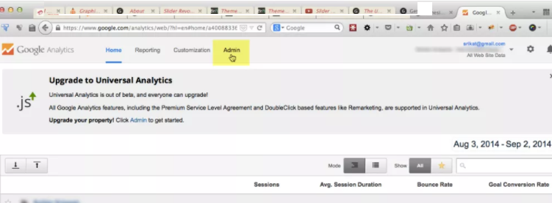
Step 2:
Once logged in, click Admin on the top.

Slide 8
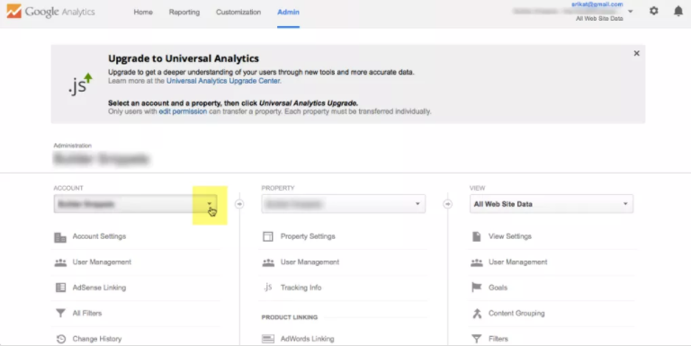
Step 3:
Click on the Account dropdown and select the account under which would like to add a new website.

Slide 9
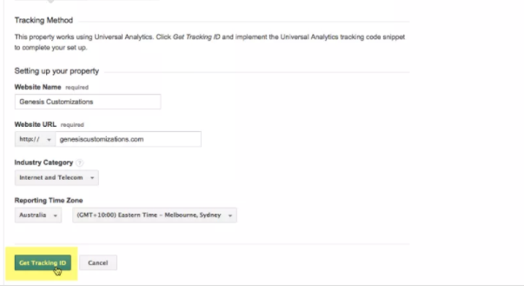
Step 4:
Fill in website details and click Get Tracking ID button.

Slide 10
THANK YOU

